Slide 1
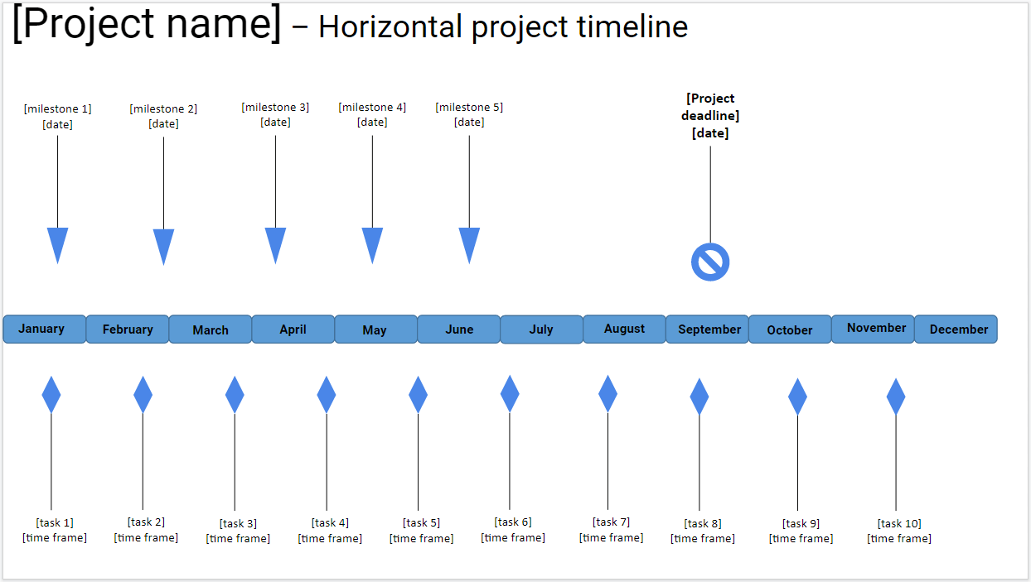
Instructions:
*READ THIS FIRST: Go to File, Make A Copy, and then fill out the template. Delete this message.
Add your project name
Add your milestones, and their dates
Add you tasks, and their the dates when you’re supposed to tackle them (e.g. August 4th - August 10th; 9 am - 12 pm, August 1pth).
Add your overall project deadline
MILESTONES:
Press SHIFT and select the entire desired milestone arrow
Drag & drop it at the desired place on the timeline
TASKS:
Press SHIFT and select the entire desired task arrow
Drag & drop it at the desired place on the timeline
PROJECT DEADLINE:
Press Shift and select the entire project deadline arrow
Drag & drop it at the desired place in the timeline
PRODUCTIVITY TIP: Track time with Clockify.me, to improve the estimations you’ll make about task durations

Slide 2
[Project name] – Horizontal project timeline
[milestone 3] [date]
[milestone 4] [date]
[milestone 5] [date]
[Project deadline] [date]
[milestone 1] [date]
[milestone 2] [date]
January
February
March
April
May
June
July
August
September
October
November
December
[task 1] [time frame]
[task 2] [time frame]
[task 3] [time frame]
[task 4] [time frame]
[task 5] [time frame]
[task 6] [time frame]
[task 7] [time frame]
[task 8] [time frame]
[task 9] [time frame]
[task 10] [time frame]

